Slide 1
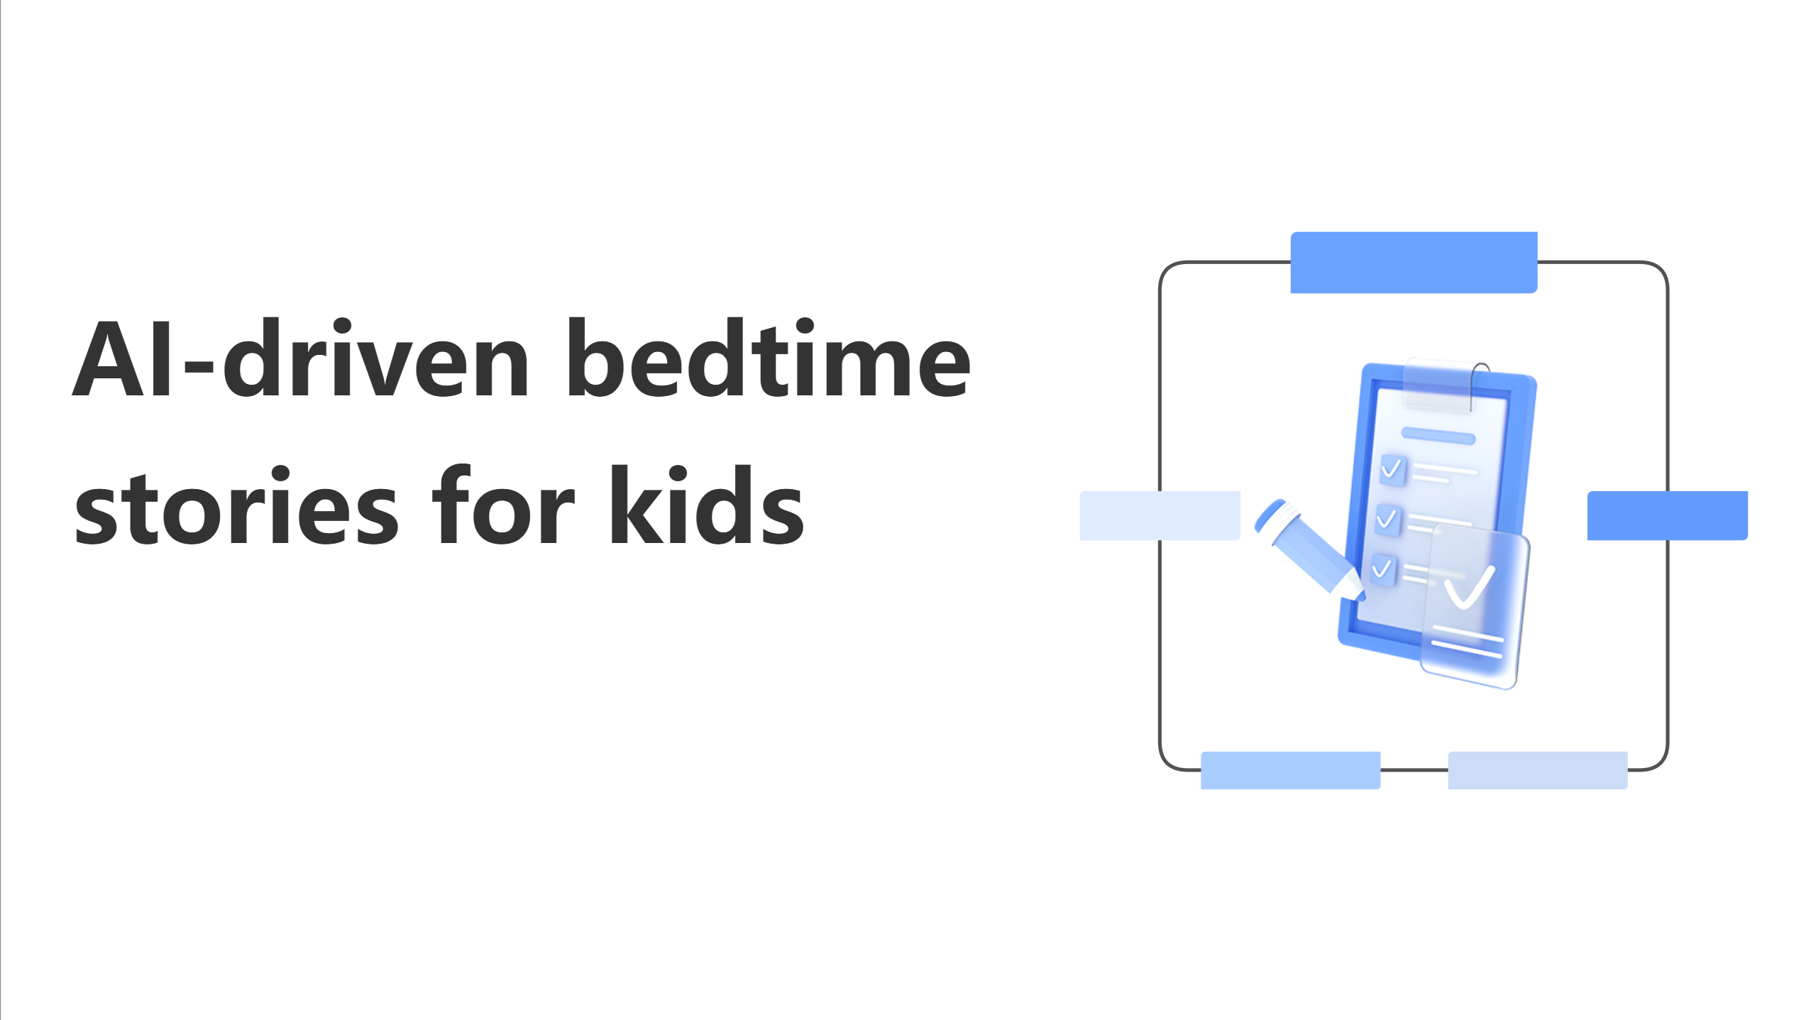
Notes:
"Hi, I’m Sumukh Paspuleti. Every night, millions of parents face the same challenge: creating engaging bedtime routines that actually work. Traditional stories bore kids, personalization is non-existent, and parents are exhausted trying to make bedtime meaningful every single night.
Today, I'm introducing **Dream Flow** AI-driven bedtime stories that transform how families connect at bedtime."

Slide 2
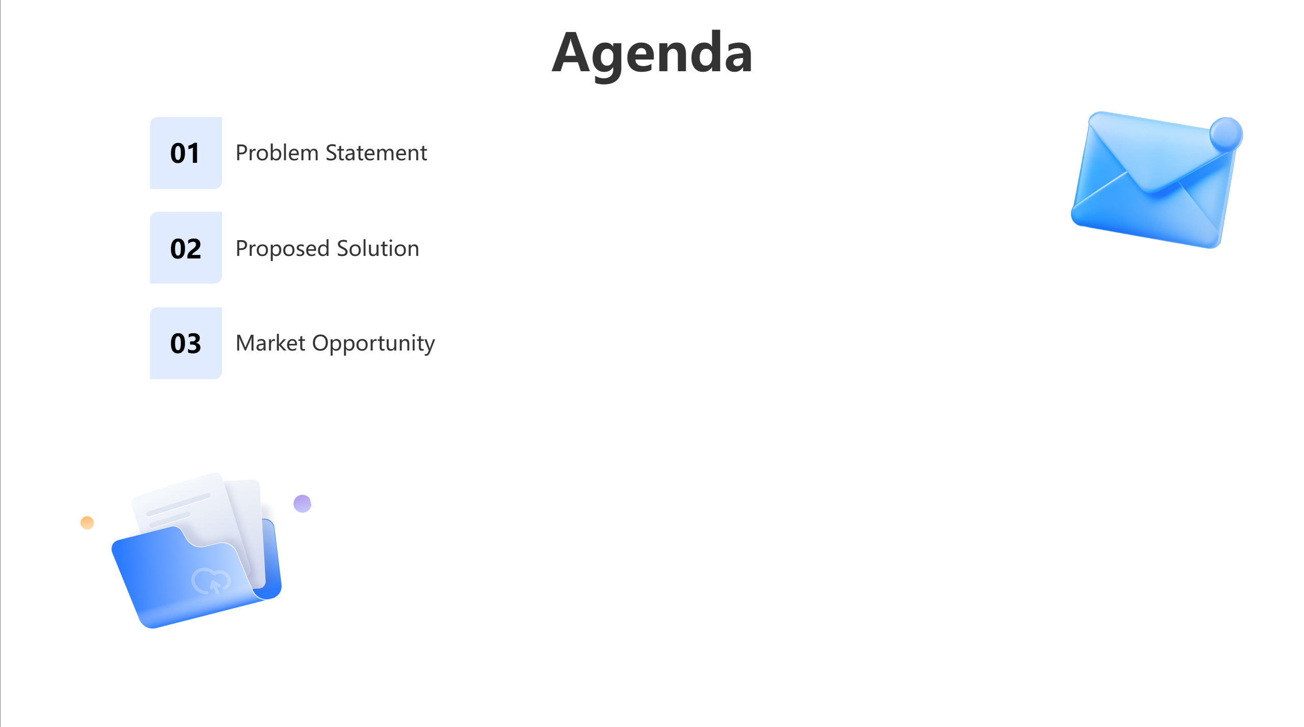
Notes:
We are first going to go over the problem statement then the proposed solution and then the market opportunity.

Slide 3
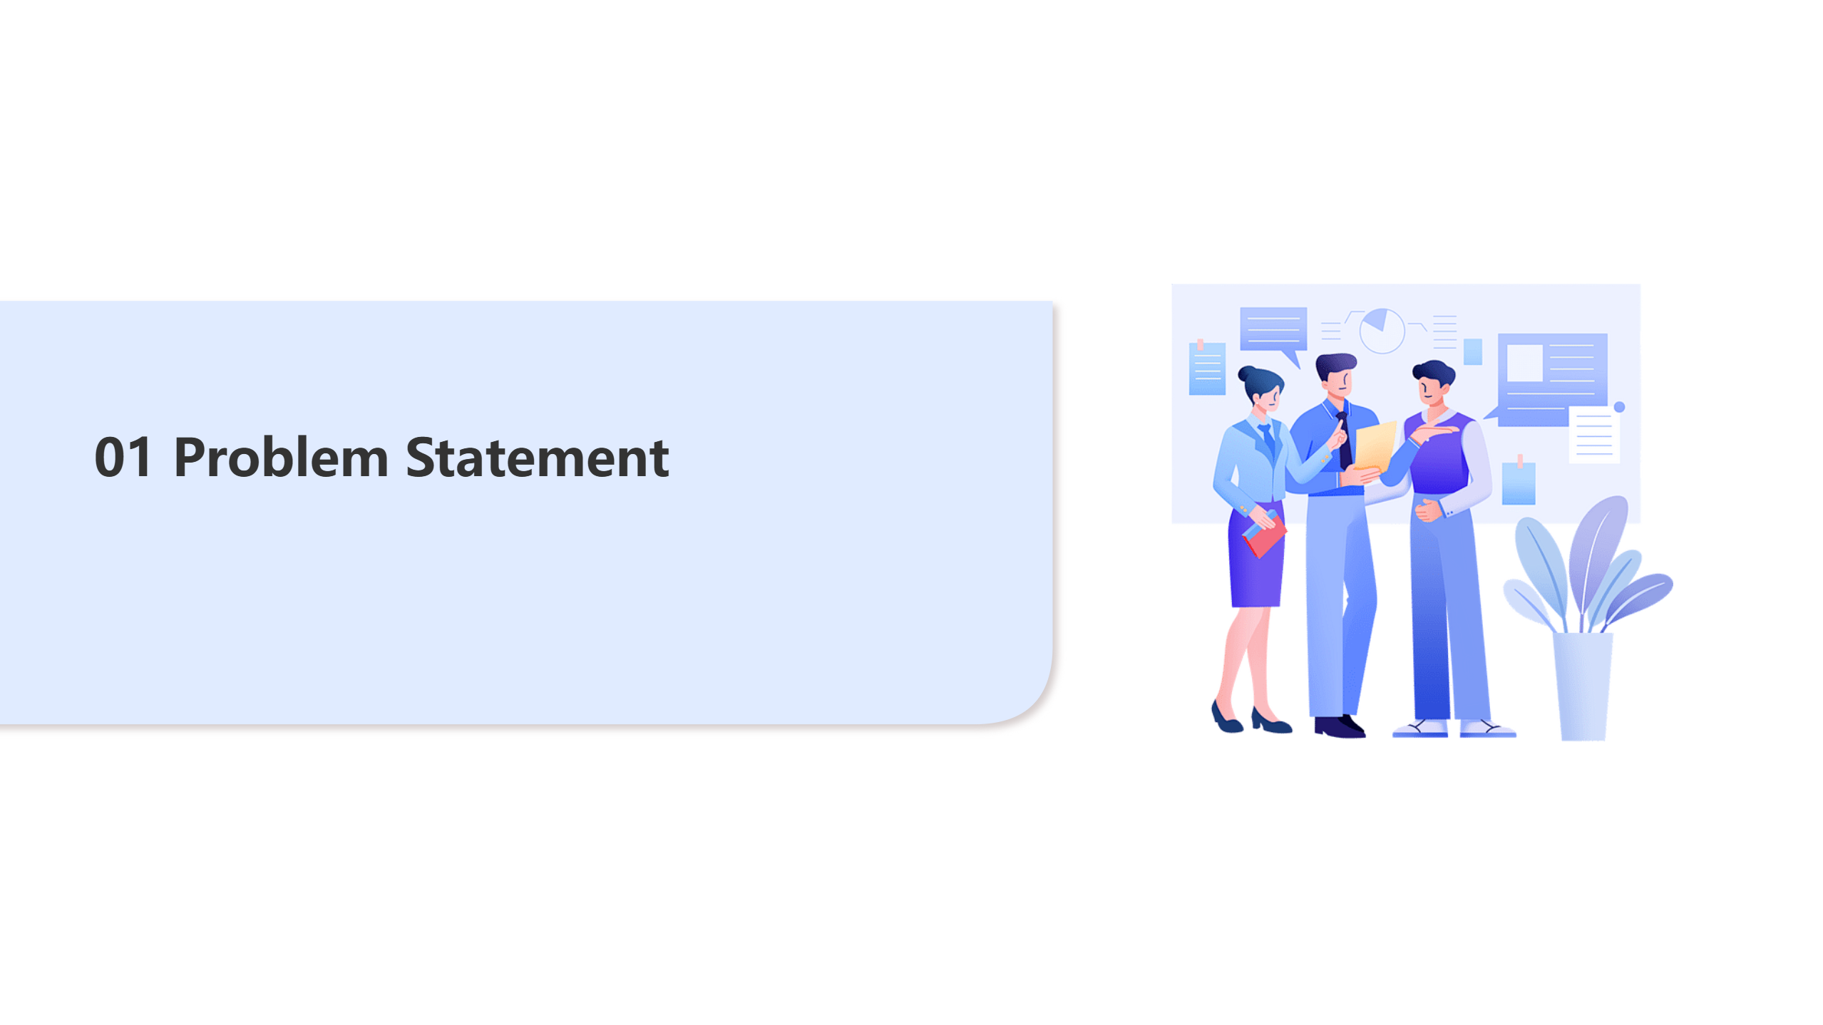

Slide 4
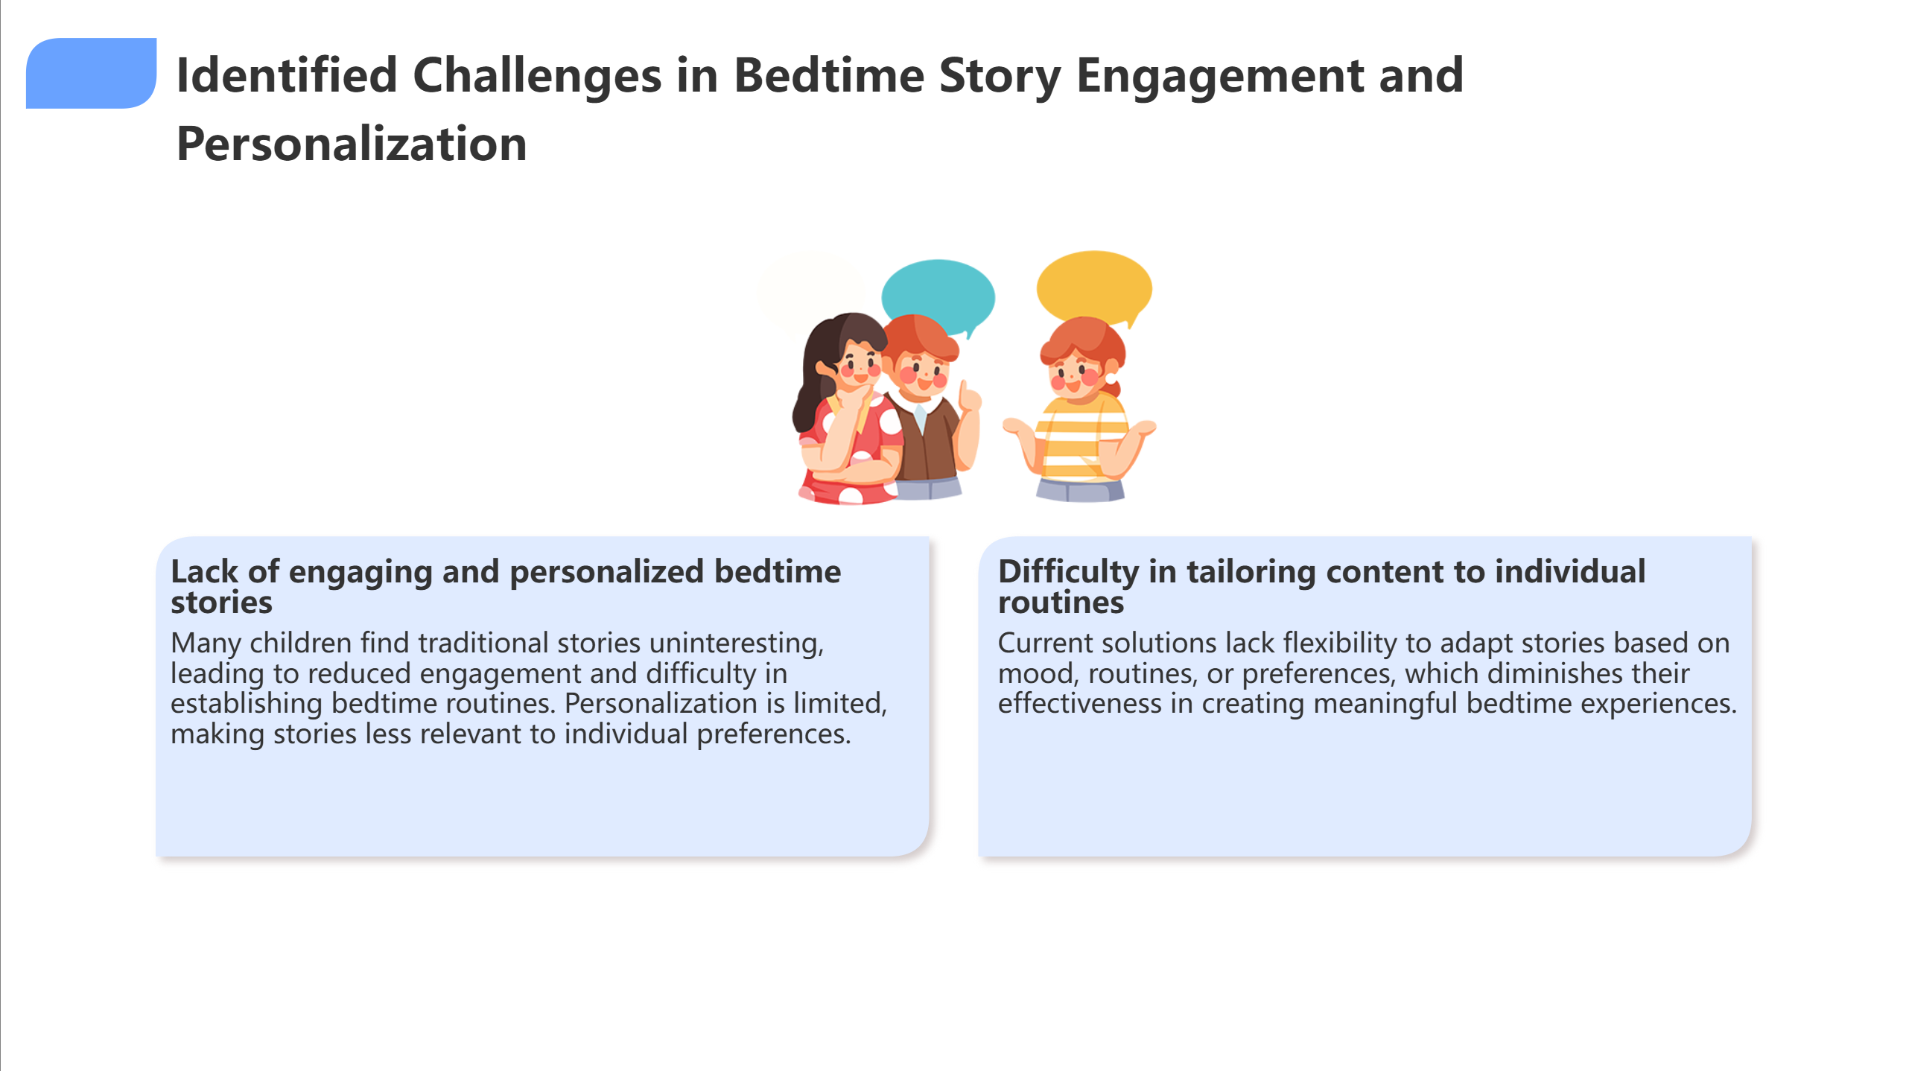
Notes:
"Let me share the challenges we've identified. First, there's a **lack of engaging and personalized bedtime stories**. Many children find traditional stories uninteresting, making it difficult to establish consistent bedtime routines.
Second, current solutions have **difficulty tailoring content to individual routines**. They lack flexibility to adapt based on mood, preferences, or family dynamics.

Slide 5
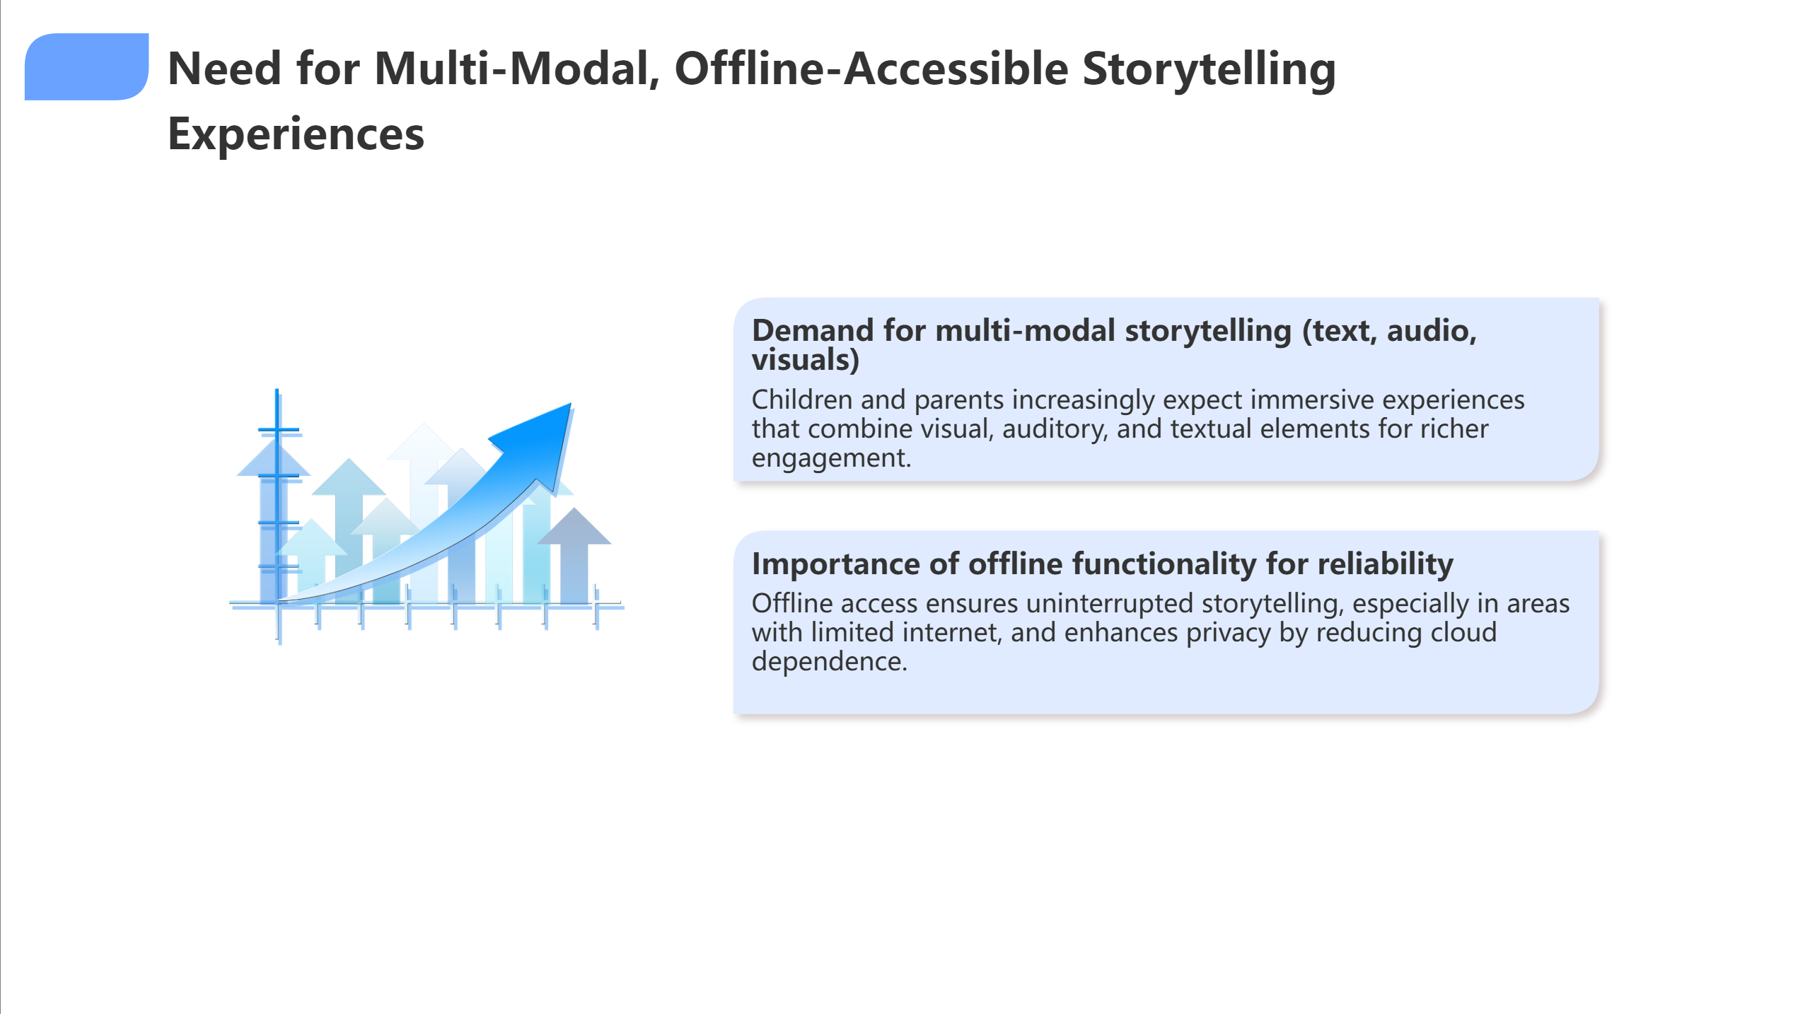
Notes:
Most importantly, there's a **critical need for multi-modal, offline-accessible storytelling**. Children and parents expect immersive experiences combining visual, auditory, and textual elements, but with reliable offline functionality.

Slide 6
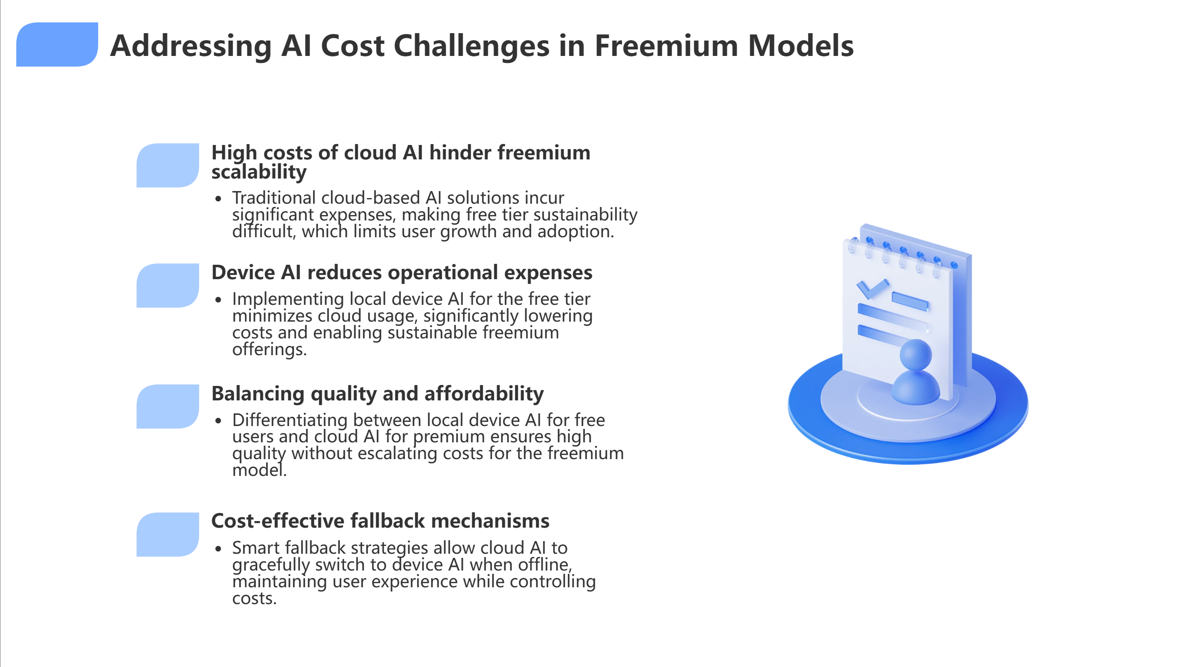
Notes:
But here's the core challenge that's breaking the entire freemium model: **AI unit economics simply don't work**. Traditional cloud-based AI solutions incur significant expenses - we're talking dollars per story generation - making free tier sustainability nearly impossible. This forces companies to either eliminate free tiers entirely, severely limit usage, or operate at unsustainable losses.

Slide 7
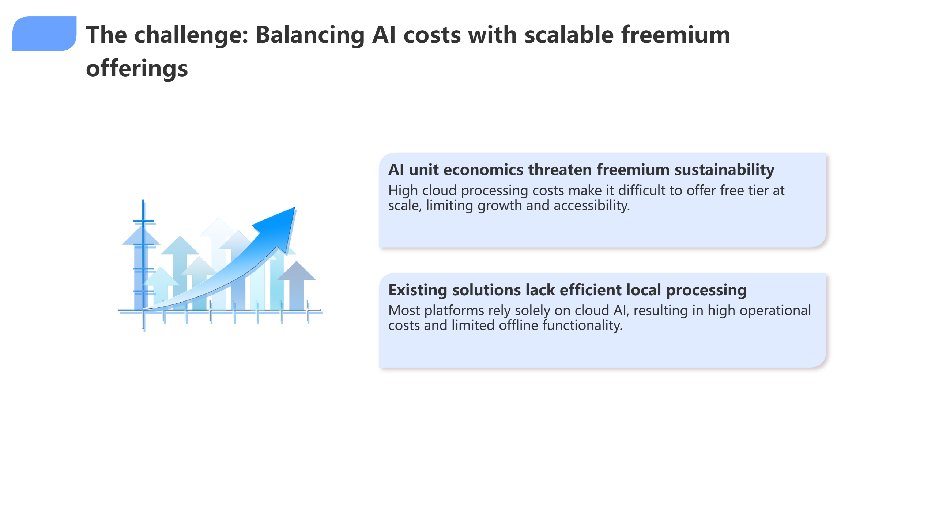
Notes:
The solution isn't just reducing costs - it's **intelligently balancing quality and affordability**. Device AI can reduce operational expenses by up to 90% for basic content, while cloud AI delivers premium quality for paying users. Smart fallback mechanisms ensure seamless user experience whether online or offline, maintaining engagement while controlling costs."

Slide 8
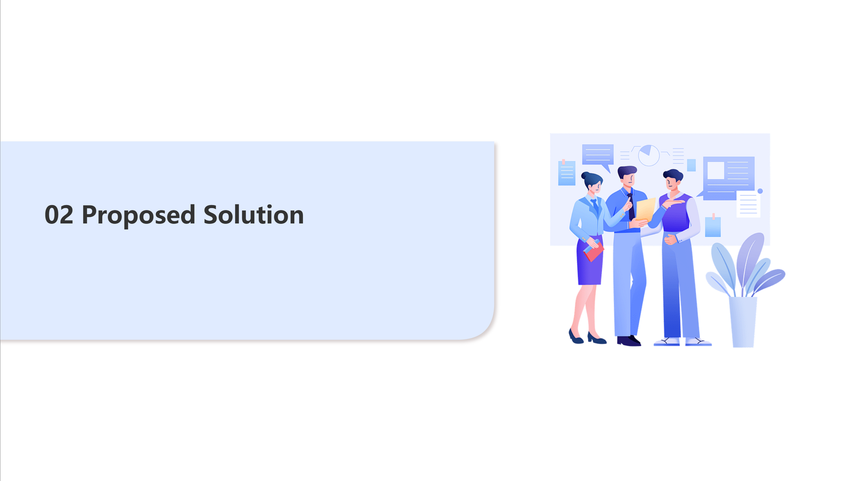

Slide 9
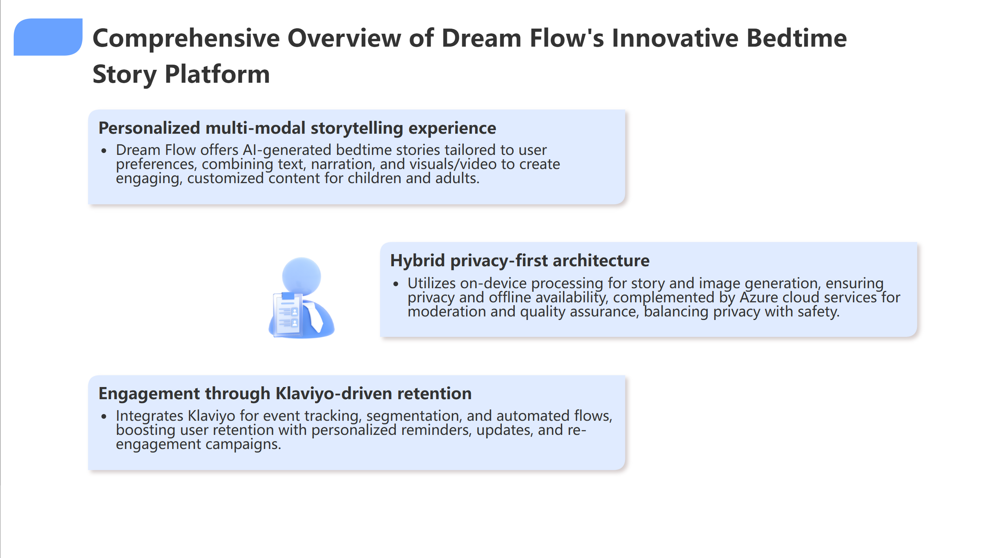
Notes:
"Dream Flow solves this with a comprehensive approach. We offer **personalized multi-modal storytelling experiences** - AI-generated bedtime stories tailored to user preferences, combining text, narration, and visuals for engaging, customized content.
Our **hybrid privacy-first architecture** is the key differentiator. We utilize on-device processing for story and image generation, ensuring privacy and offline availability, complemented by Azure cloud services for moderation and quality assurance.

Slide 10
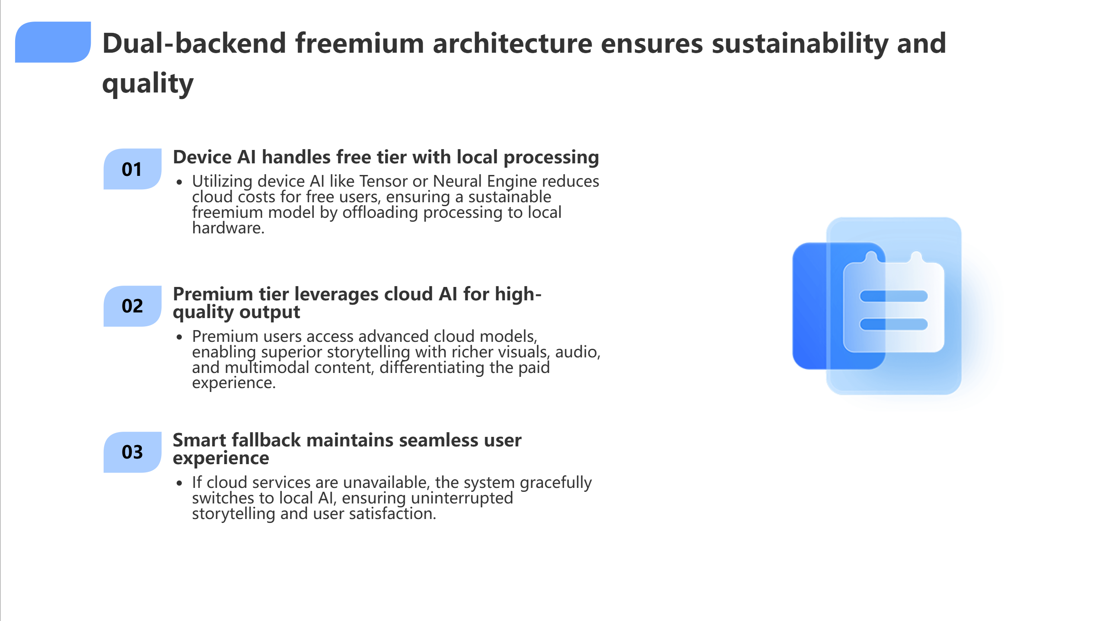
Notes:
Here's our smart freemium strategy: **Device AI handles the free tier** with local processing, reducing operational costs. **Premium tiers leverage cloud AI** for superior quality output. And our **smart fallback system** maintains seamless user experience when switching between modes.

Slide 11
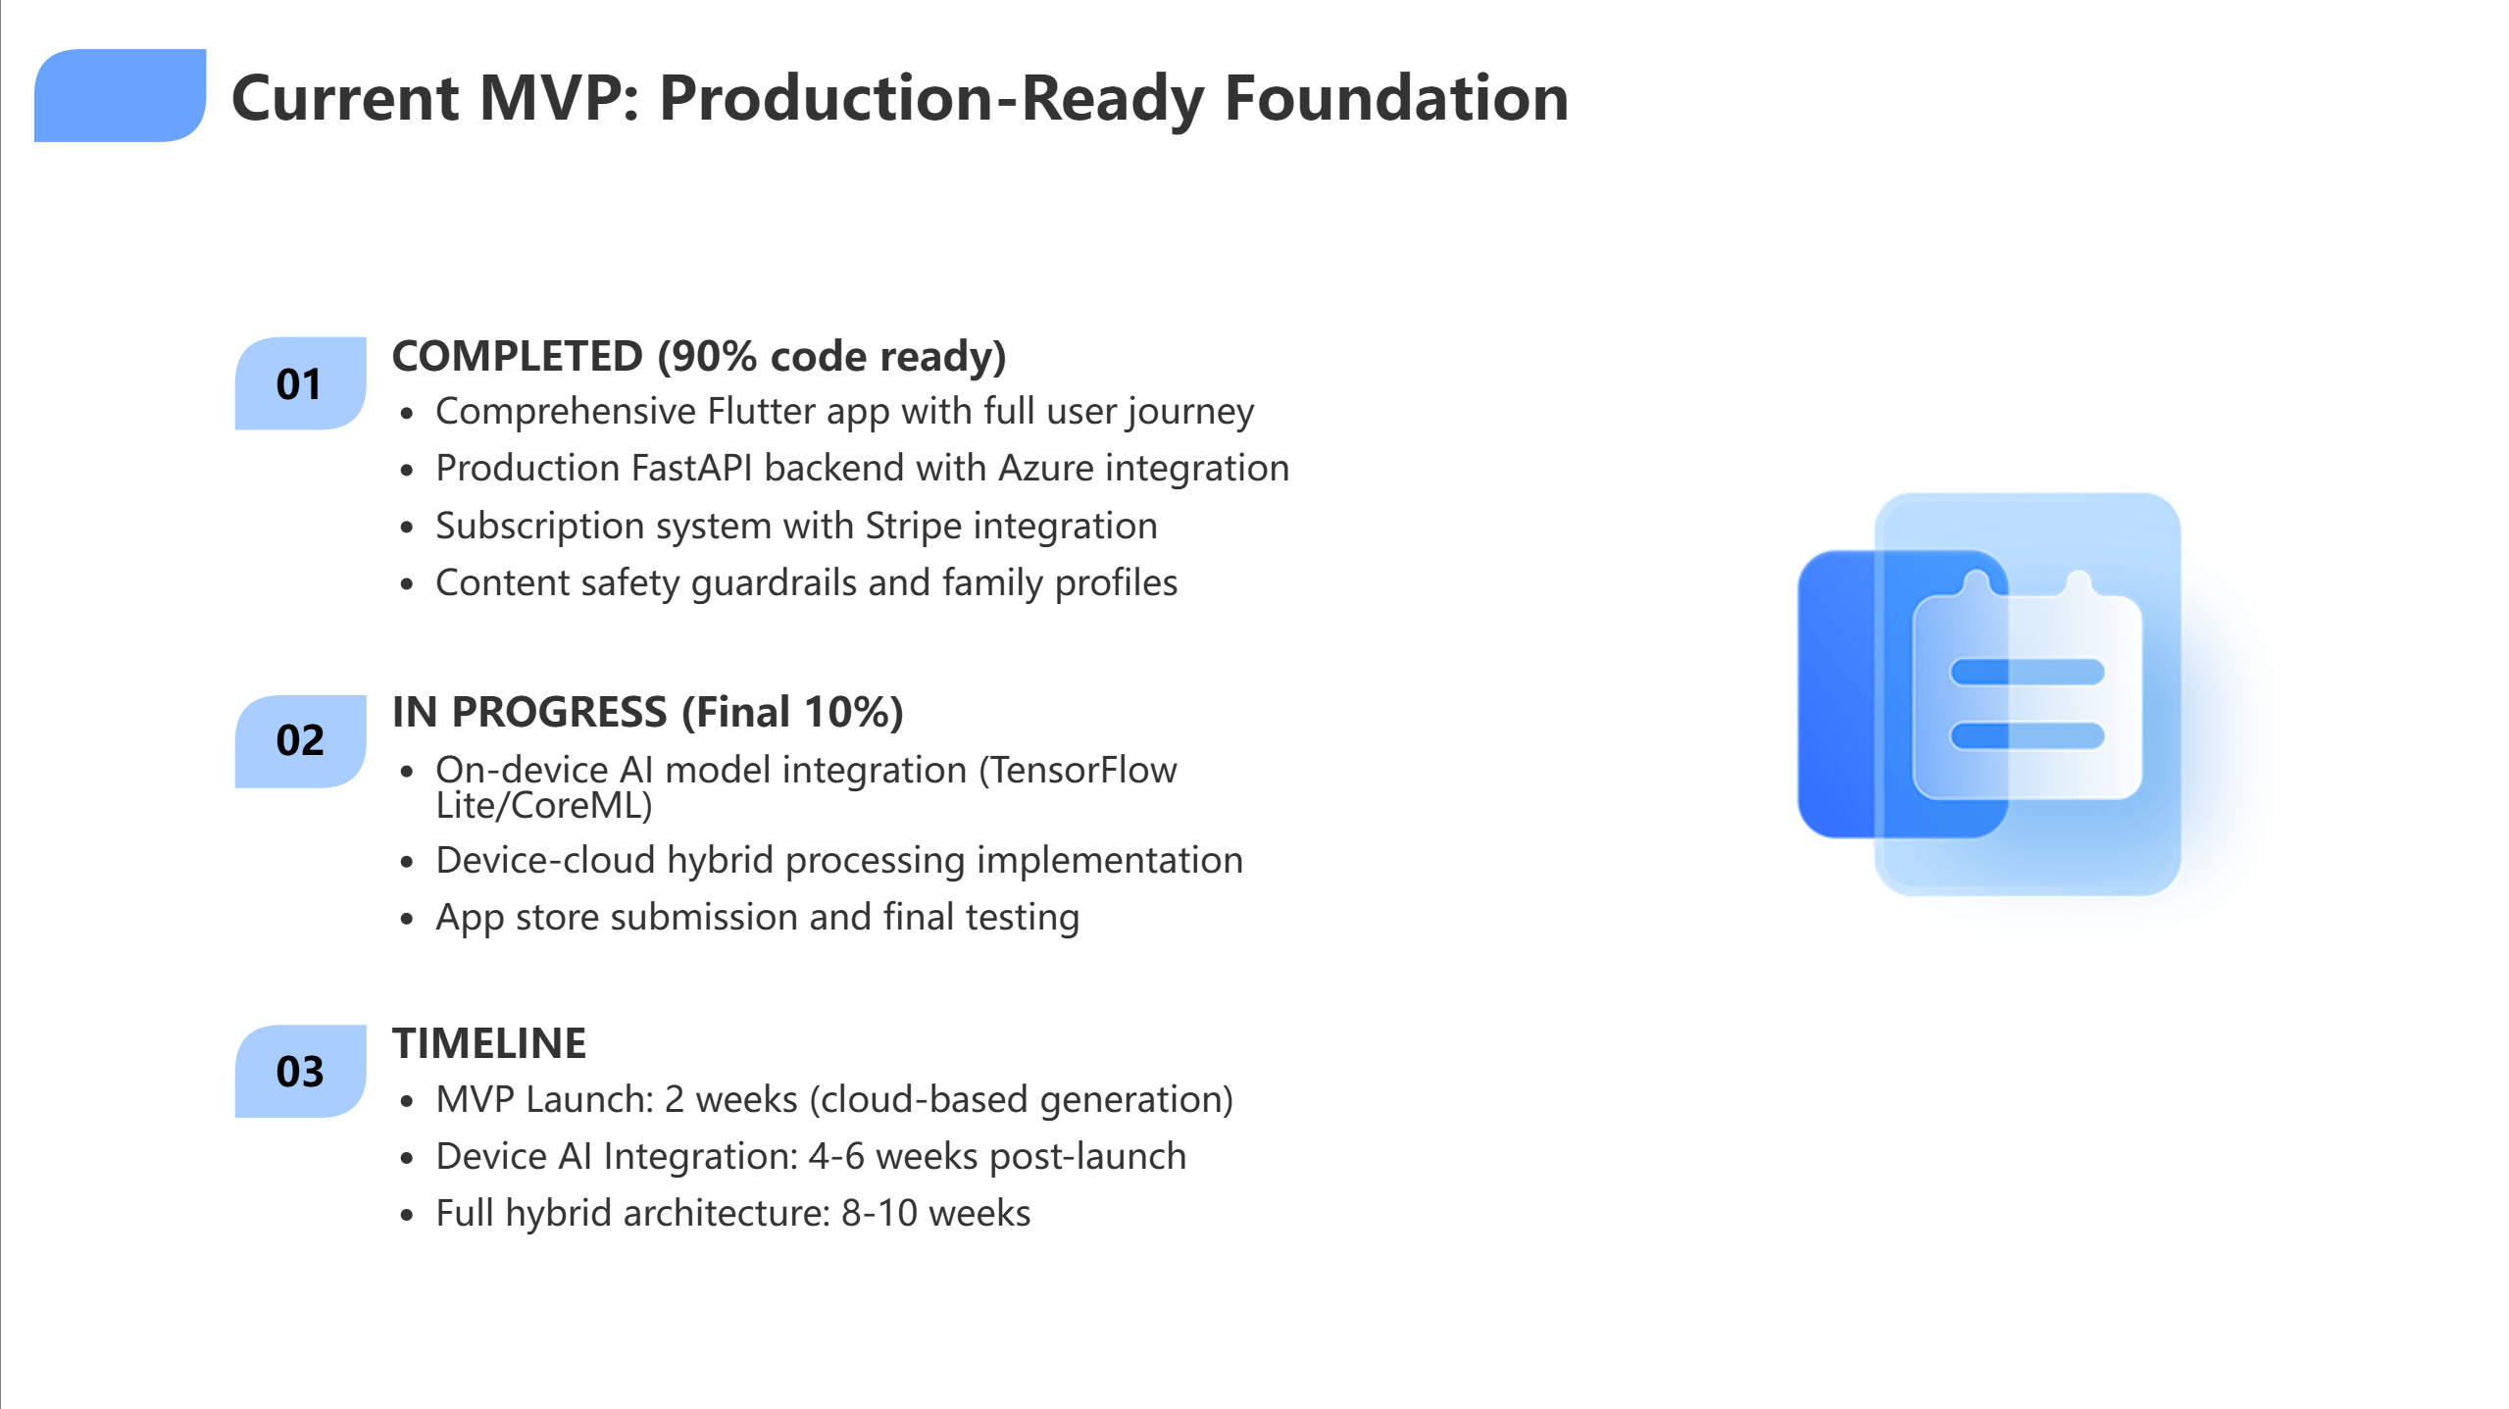
Notes:
Our MVP is **90% complete** - comprehensive Flutter app, production FastAPI backend, full Azure integration, and subscription system with Stripe."

Slide 12
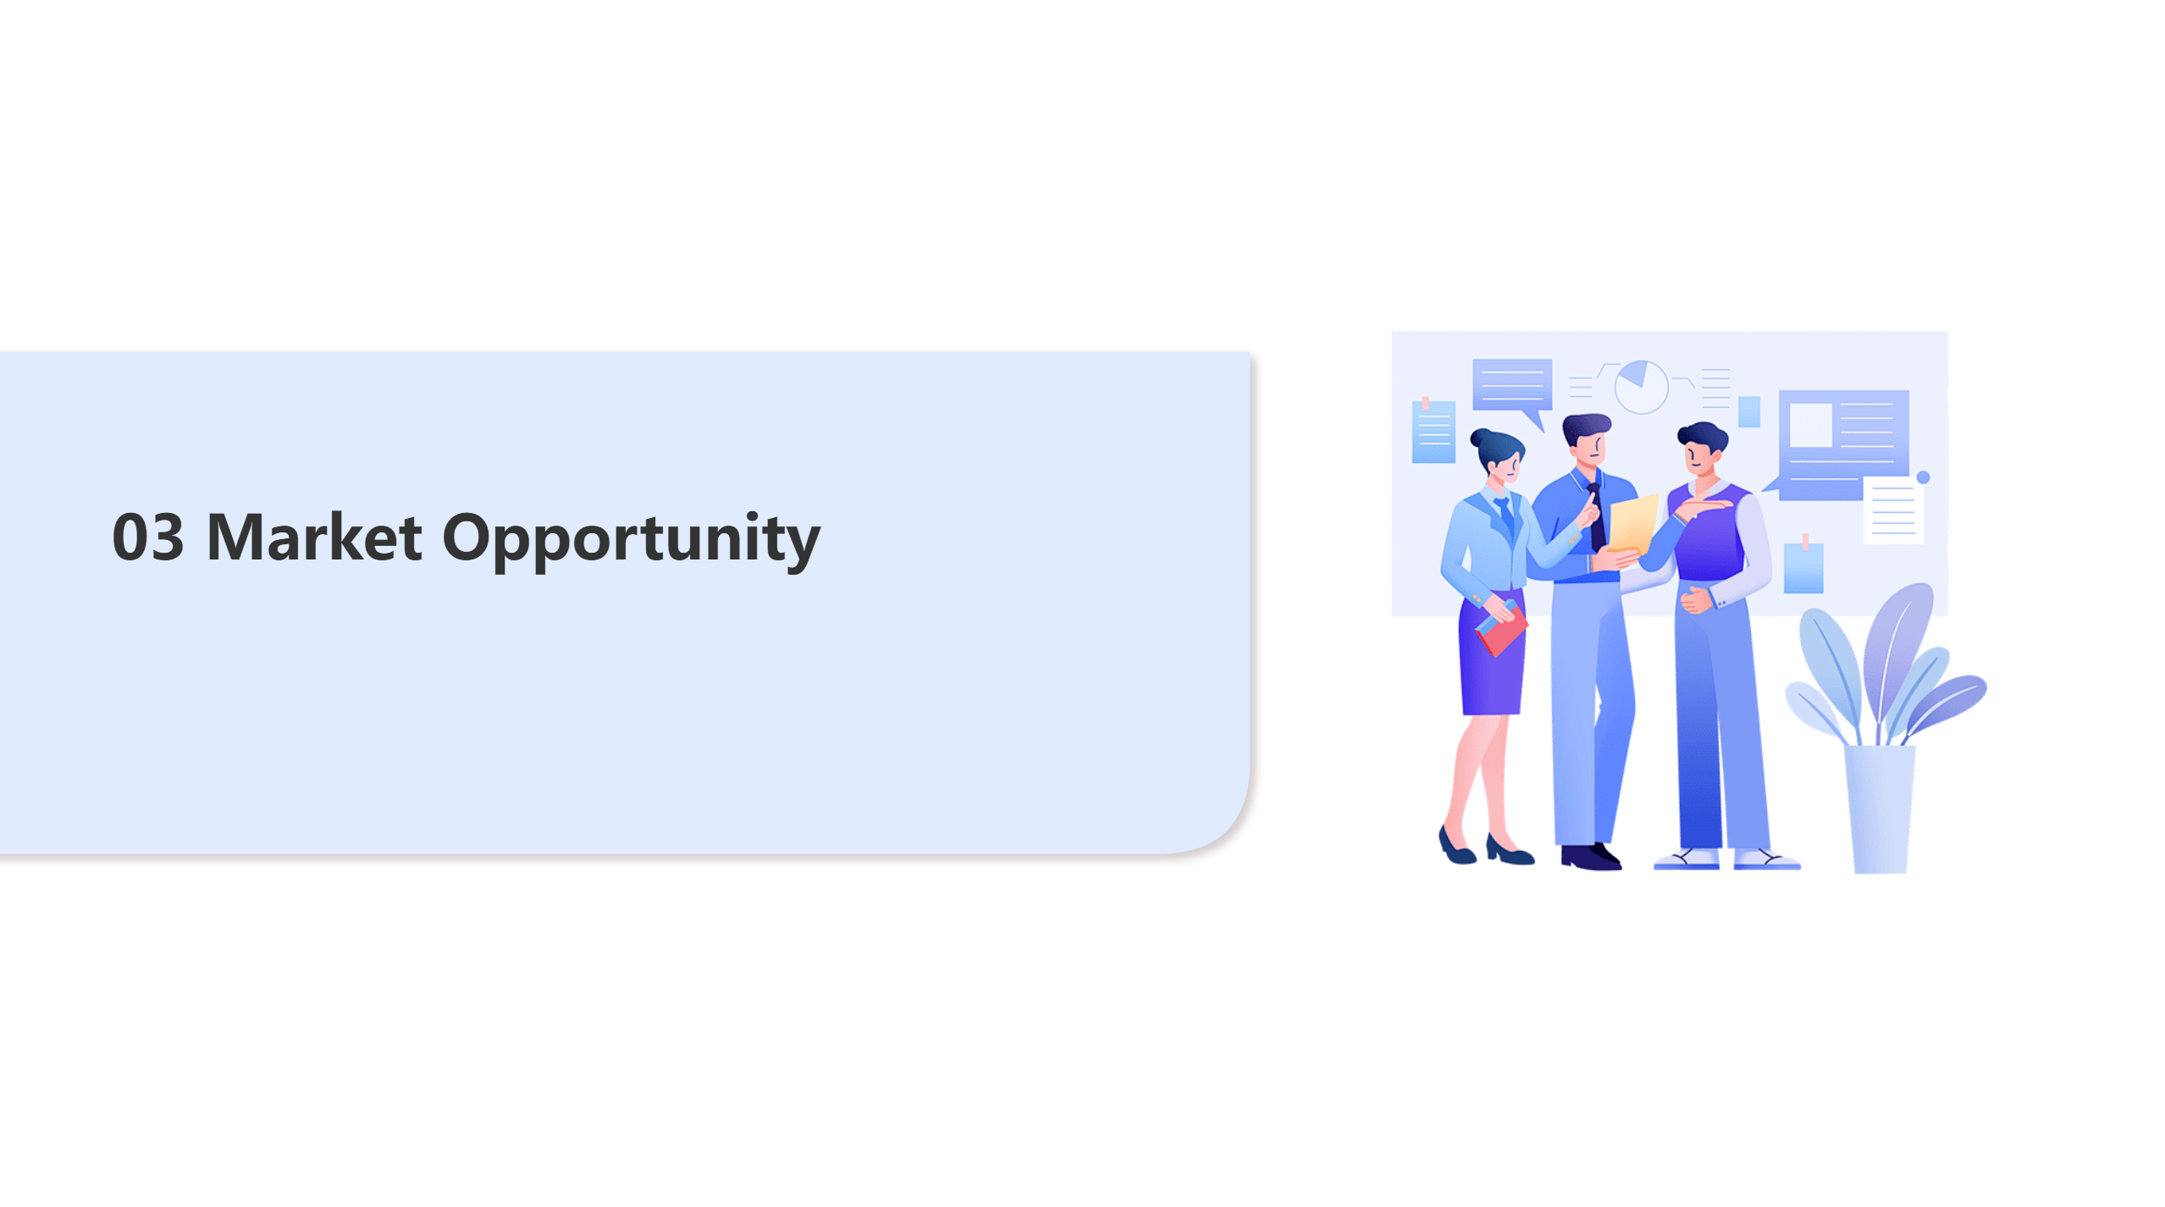

Slide 13
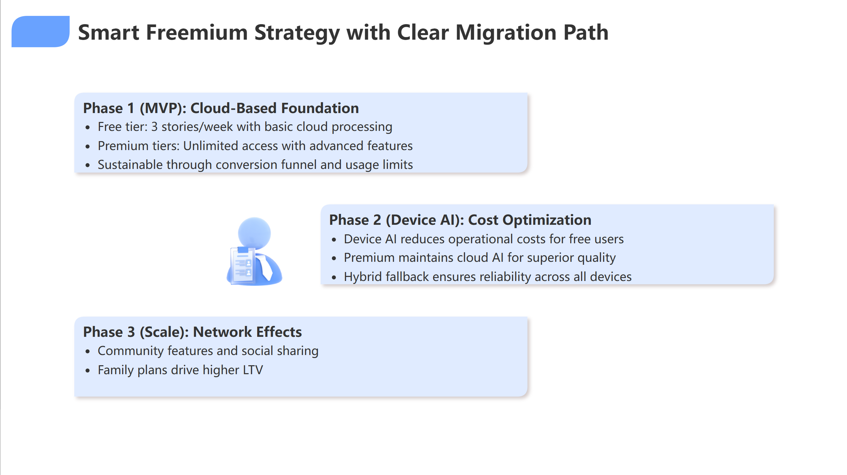
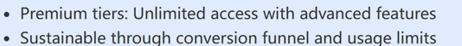

Notes:
"Our implementation roadmap is clear. **Phase 1 MVP launches in 2 weeks** with cloud-based foundation - free tier offers unlimited stories per week, premium tiers provide unlimited access with advanced features.
**Phase 2 introduces device AI** for cost optimization - reducing operational costs for free users while premium maintains cloud AI for superior quality.
**Phase 3 scales with network effects** - community features, social sharing, and family plans that drive higher lifetime value.
We're not just building an app - we're solving AI unit economics through intelligent architecture differentiation."

Slide 14
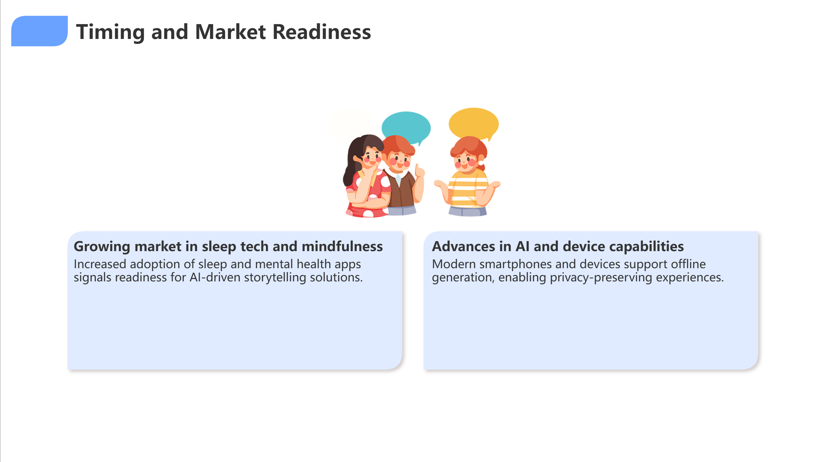
Notes:
"Every night, a parent opens Dream Flow, inputs their child's mood and preferences, and within seconds receives a personalized story with narration and visuals - all processed with strict child safety guardrails.
We're seeking **$500K seed funding** to complete device AI integration and accelerate market launch.
Dream Flow transforms bedtime routines for families worldwide while building sustainable AI economics that actually work.

Slide 15
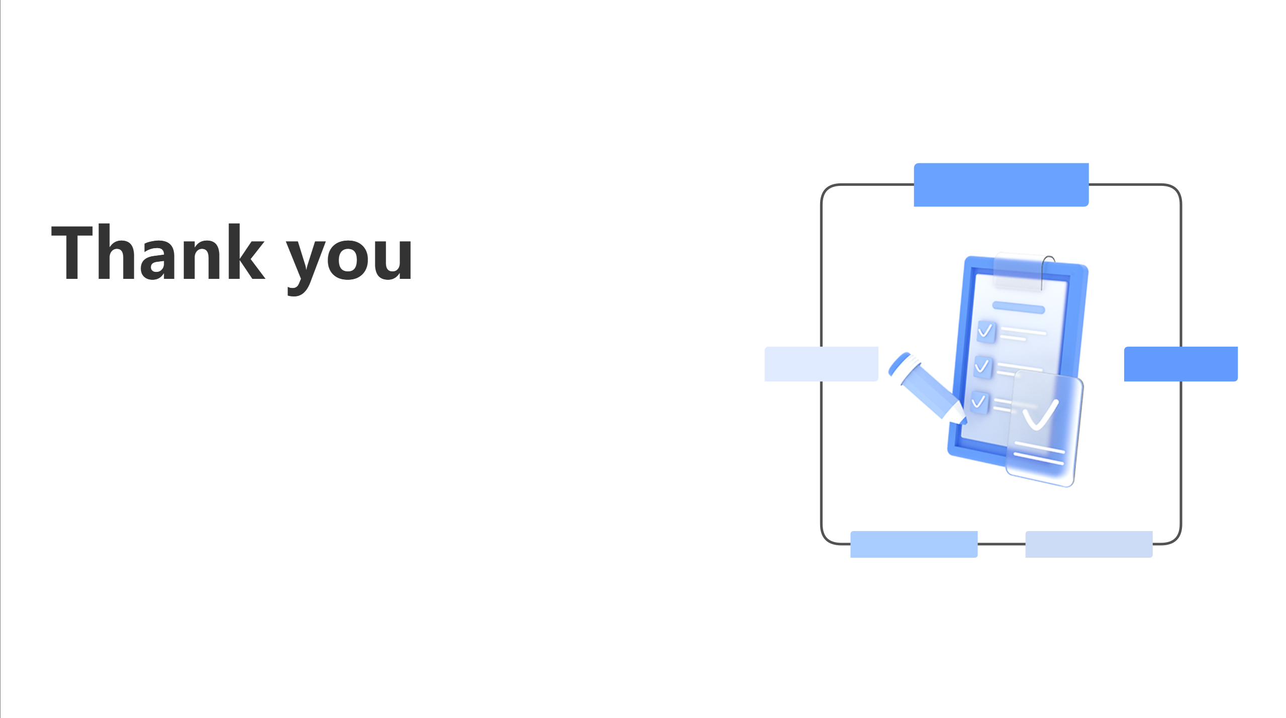
Notes:
Thank you."

